Slide 1
0A001 – Technical English
Classification
Organizational Strategies

Slide 2
WHAT IS CLASSIFICATION?
  Merriam-Webster definition:
  “Systematic arrangement in groups or categories according to established criteria ”
  → A method of organizing and explaining information.

Slide 3
DIVISION
&
CLASSIFICATION
Two methods of organizing and explaining information.
1) DIVISION
Divides large subject into smaller categories.
2) CLASSIFICATION
Groups like items into logical categories.

Slide 4

DIVISION
Division – Moving down the ladder of abstraction
Use Division to break a complex idea into smaller, understandable parts

Slide 5
CLASSIFICATION
Classification – Moving up the ladder of abstraction
Use Classification to group similar items together.

Slide 6

DIVISION & CLASSIFICATION
  Another way to look at it…

Slide 7
DIVISION
Going from general to specific
Computer
Personal
Commercial
Desktop
Portable
Server
Client

Slide 8
CLASSIFICATION
Grouping many into one category
Windows
UNIX
Operating
System
LINUX
Mac

Slide 9
GUIDELINES FOR CLASSIFICATION
Principles & Categories (page 75)
DEFINITION – Principles
Principles are the features we use to categorize the subjects of the group into categories.
EXAMPLE
The PRINCIPLE of gender (male or female) can be used to categorize the students in the class.
All Students
Male
Students
Female
Students

Slide 10
GUIDELINES FOR CLASSIFICATION
Principles & Categories
DEFINITION - Categories
Categories are the smaller groups with shared characteristics.
All Students
Male
Students
Female
Students
CATEGORIES

Slide 11
GUIDELINES FOR CLASSIFICATION
3 Rules of Principles
Must be appropriate
Must be consistent
Subgroups must be complete without leaving out any major subgroups.

Slide 12
GUIDELINES FOR CLASSIFICATION
5 Rules of Categories
Be distinct
Be meaningful (not superficial)
Be measurable against the same standard
Ex. Price, Quality, Durability, Time, Quantity
Avoid including too many diverse elements
Avoid being too simplistic

Slide 13
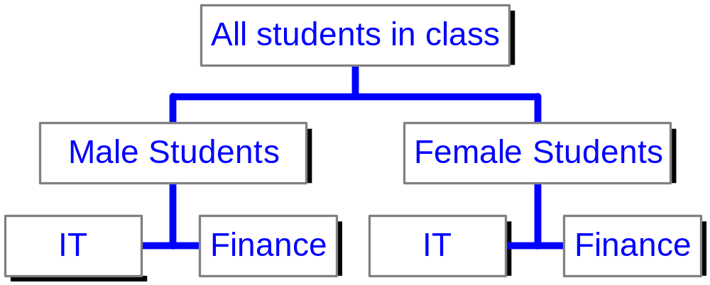
CLASSIFICATION EXAMPLE
OBJECTIVE
To determine the appropriate marketing target group which will have the most interest in IT.
Principle #1 = Gender
Principle #2 = Major
Are the categories…
Distinct?
Meaningful?
Measurable against the same standards?
Too diverse?
Too complex?

Slide 14
CLASSIFICATION EXERCISE
Please get into groups.
Choose one of the following subjects:
► Music
► Movies
► Flowers
► Animals

Slide 15
CLASSIFICATION EXERCISE
Complete these 3 tasks
Write a reason why your subject needs to be classified
Create 3 categories and 1 sub-category of your subject
Present your reason and categories of your subject to the class and explain what principles you used to create the categories.

Slide 16
WHY IS CLASSIFICATION IMPORTANT FOR US?
It makes complex subjects easier to understand
It helps to present information in a logical order
It helps the audience understand information easier
EXAMPLE
► Essays are expected to present information in a logical and systematic manner.
► The writer is required to use careful thought about how to organize all the information and the best way to present them.
► Classification helps the writer in this process.

